Slide 1

Servisim
Everything about your kid’s bus journey in one place
Boun Hackers

Slide 2
Reaching the Driver is Too Hard
Parents can’t get information about their children’s school bus instantly.
It is really hard for the parents to contact the driver when they need to.
http://photobucket.com/gallery/user/jmt939/media/cGF0aDovY29uY2VybmVkbW9tLnBuZw==/?ref=

Slide 3
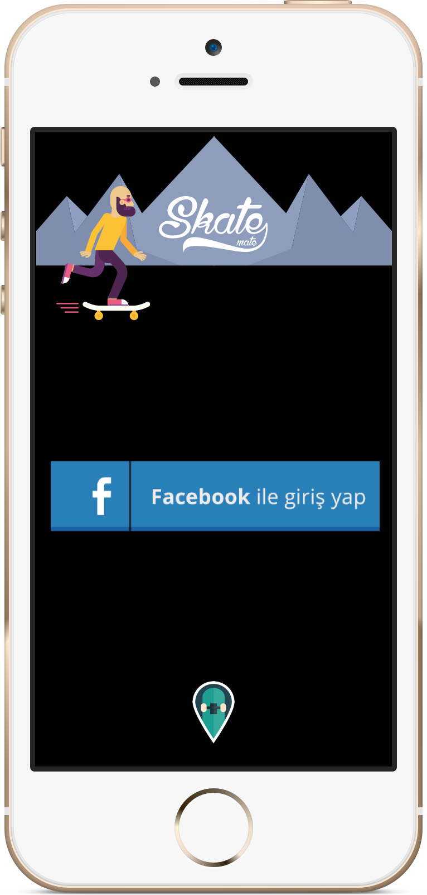
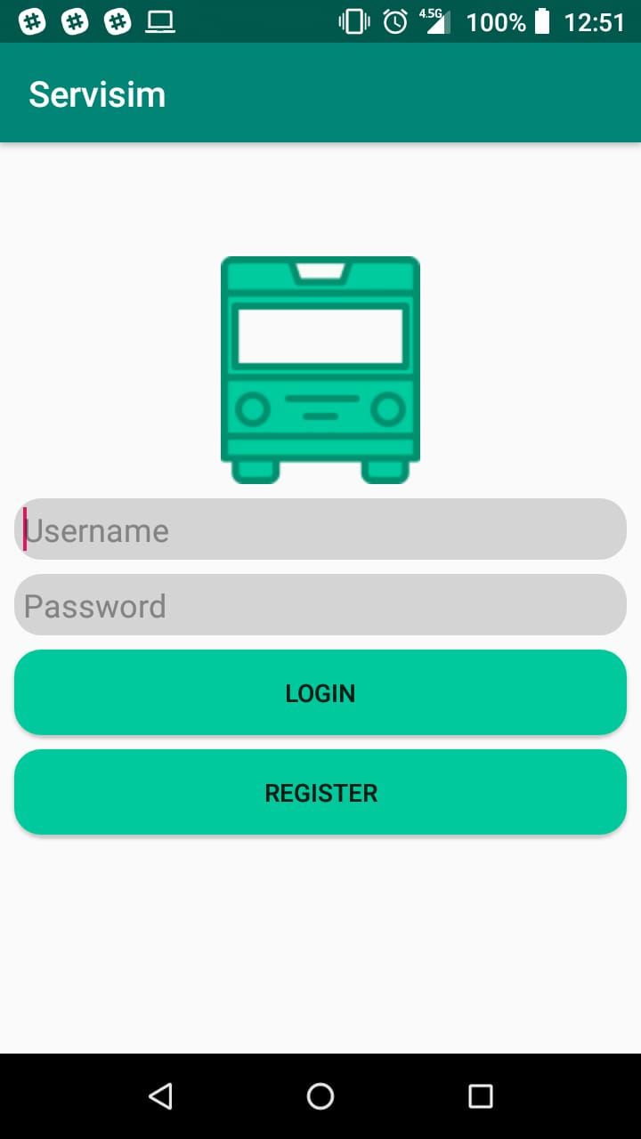
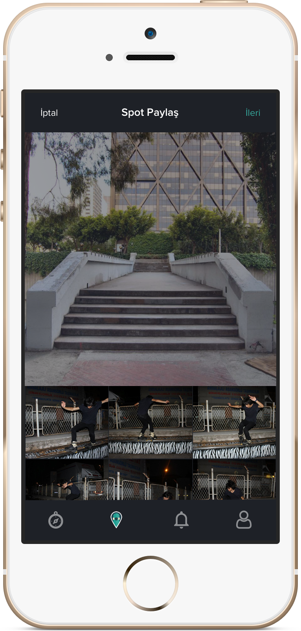
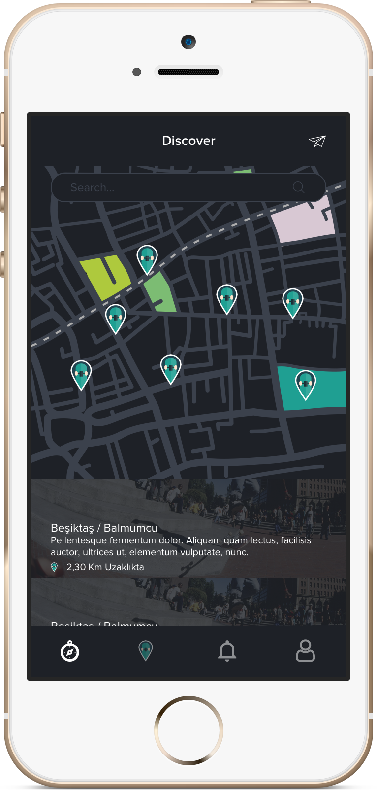
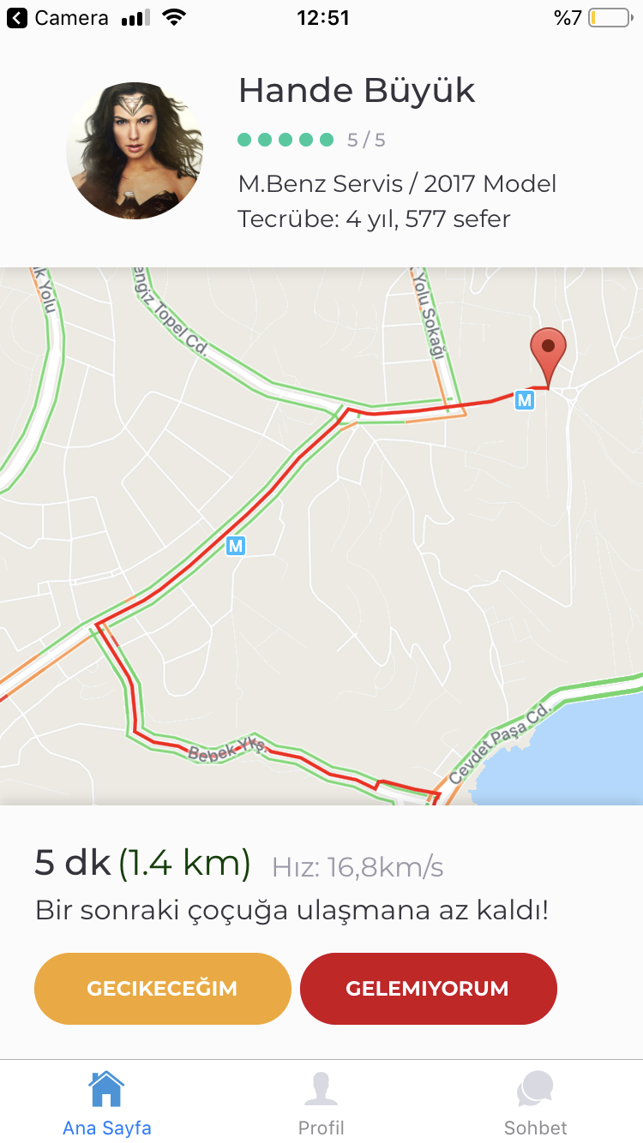
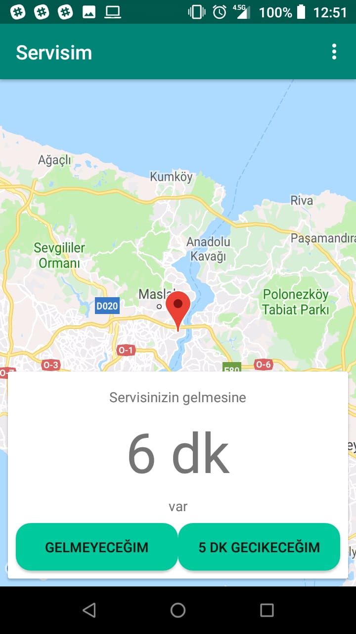
Getting Information & Contacting the Driver Made Easy
Servisim enables parents to track their children’s school bus and easily inform the bus driver when needed.

Slide 4
User Scenario – Pelin & Bora’s Mother Sevilay
Sevilay is 35 years old, mother of two: Pelin (7) & Bora (6)
Gets notification indicating Bora’s bus will be here in 5 minutes. Marks Bora as “going to be late” (can be used only 3 times a month)
Starts preparing Pelin after learning that Bora gets on the bus
While watching TV, sees that both children got to school safely.
https://www.pinterest.com/pin/498562621242679346/

Slide 5
User Scenario – Bus Driver Ahmet Abi
much school bus
wow
Ahmet is 40 years old. Driving school busses for 15 years.
First day of school. Looks at the map to see the optimum route
One of the students marks himself as “not coming”. Ahmet sees the revised optimum route.
Car breaks down the next day, so marks himself as “not coming”. His rating decreases.
Such fuel efficiency
https://media0ch-a.akamaihd.net/87/11/fb266160e11bf0bb16f8a458b7356c21.jpeg

Slide 6
Market Analysis
Total Available Market (52 billion $)
Global school & employee bus industry
Current Serviceable Available Market (2 billion $)
Turkey’s school bus industry
Current Serviceable Obtainable Market (10 mil $)
%0.5 of our current serviceable available market (revenue of our main competitor)
10 mil $
2 billion $
52 billion $

Slide 7
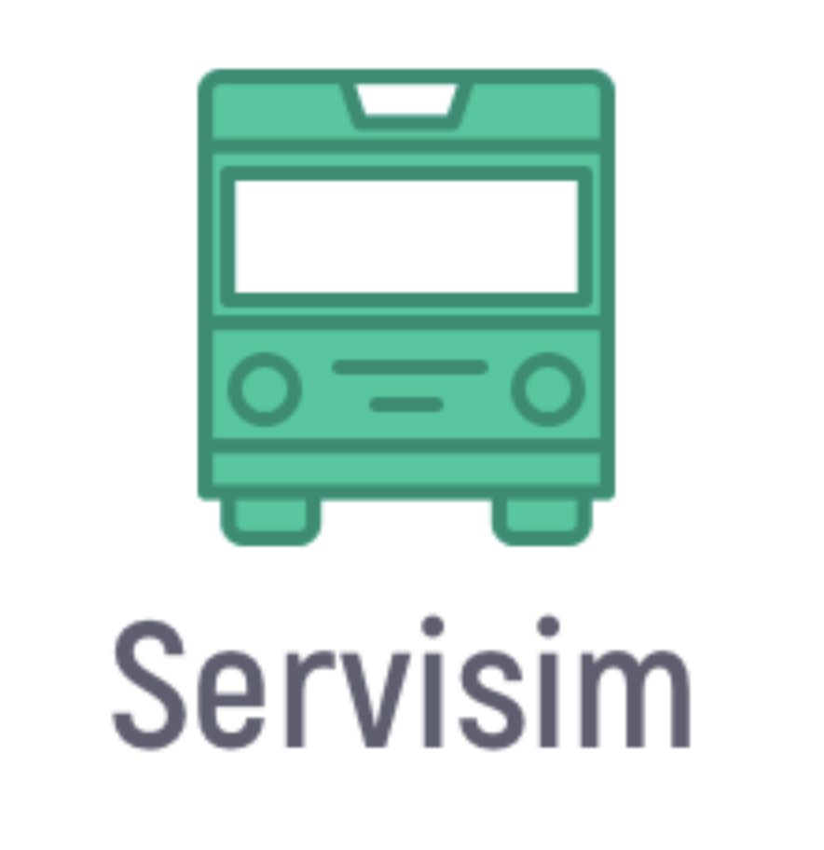

Easy to use
No information
Get a lot of information
Traditional Methods
Hard to use

Slide 8
Business Model & Marketing Strategy
Semesterly / Yearly Subscription for each user
Much cheaper than other competitors (no need for physical device (only Servisim card) & no other entity who gets commission)
Reaching out to schools and parents by email marketing & social media
Pay per use to bus operating companies

Slide 9
Future Improvements & Roadmap
Autonomous busses (no need for bus operating companies)
Connected busses (vehicle usage optimization)
Employee bus features (check-in for night shift, etc.)
Integration to big bus companies like Varan, Flixbus
Renting the bus for other activities when idle
Camera monitoring inside the bus
Alert system for passengers not wearing seatbelt
Alert the driver for not forgetting sleeping passengers in the bus

Slide 10
Working Together with Mercedes-Benz
Easily integrable to Mercedes– Benz busses.
With autonomous busses, we won’t need bus operating companies for the driver. Mercedes can offer Servisim as a service package with their busses.

Slide 11
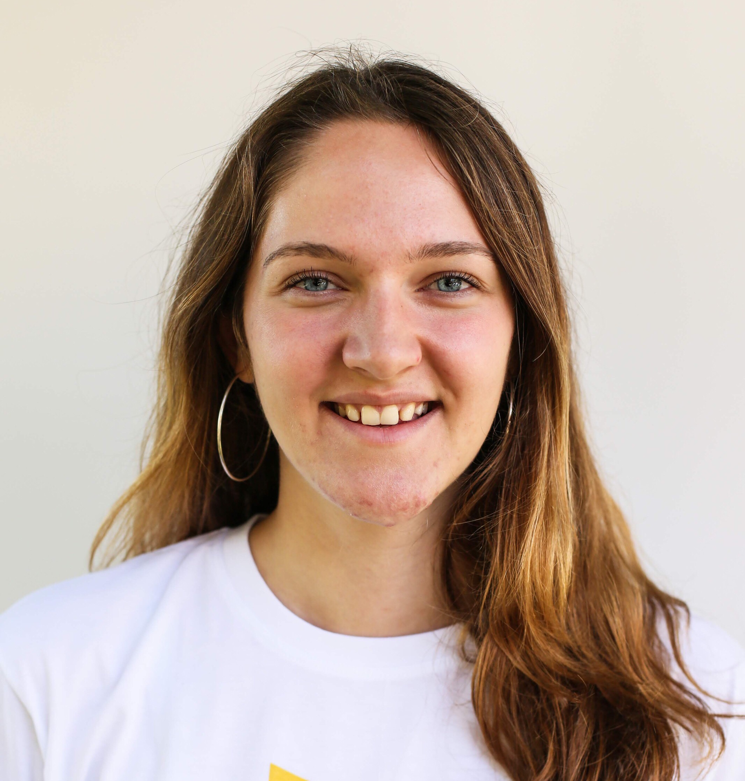
Elif Güler
Computer Engineering Student
at Boğaziçi University
Google Software Engineering Intern
in Summer 2019
Mahmut Karaca
Computer Engineering Student
at Boğaziçi University
Software Developer at Tazi.ai
Samed Düzçay
Computer Engineering Student
at Boğaziçi University
Co-founder at Lisa AI

Slide 12
Appendix
https://www.cnnturk.com/haber/ekonomi/genel/ogrenciler-artik-servis-araci-beklemeyecek
https://www.haberturk.com/ekonomi/is-yasam/haber/1622625-istanbul-da-1-milyar-liralik-servisin-kavgasi
https://www.thebusinessresearchcompany.com/report/school-and-employee-bus-services-global-market-report-2018
https://servisgeliyor.com
https://www.serviscell.com.tr
https://herecomesthebus.com
https://www.trackschoolbus.com

